Slide 1
IDS 564: Social Media and Network Analytics
Dr. Ali Tafti
session 1: January 14, 2020

Slide 2
IDS 564: Applications of Social Network Analysis
Viral marketing
Social media strategy
Knowledge sharing platforms
Recommender systems
Corporate strategy
Technology innovation and its economic effects
Healthcare literacy and education
Education and poverty reduction

Slide 3
1.1 Aspects of networks
Confluence of ideas

Slide 4
Reference disciplines
Sociology
Modeling of networks, structure & dynamics of social groups
Economics
Strategic behavior of interacting individuals and aggregate outcomes
Computer science
Methods for studying large networks.
Understanding design constraints of large computing systems
Complex feedback effects with human audiences

Slide 5
1.2 Central themes and topics

Slide 6
Graph theory
Strong vs. weak ties (e.g. email network)
Structural holes
Parts of the network where connections are missing or sparse
Network fissures: sources of conflict (e.g. Karate club)

Slide 7
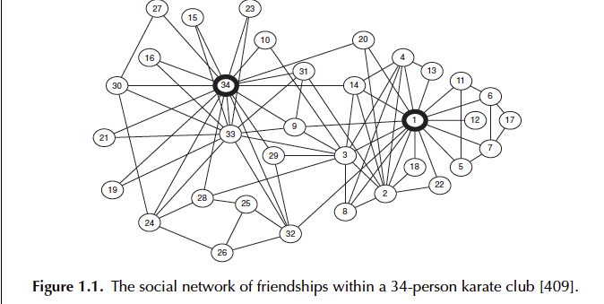
Easley and Kleinberg (2010, p.2)
Notes:
You can open karate.gml in gephi

Slide 8
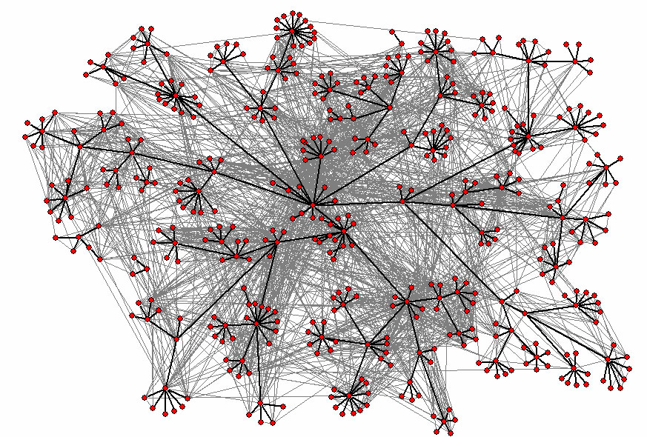
Courtesy of Lada Adamic, and Elsevier Science and Tech.
http://www-personal.umich.edu/~ladamic/img/hplabsemailhierarchy.jpg (accessed Jan. 7, 2016)
Notes:
http://www-personal.umich.edu/~ladamic/img/hplabsemailhierarchy.jpg (accessed Jan. 7, 2016)
“We derived a social network from the email logs by defining a social contact
to be someone with whom an individual had exchanged at least 6 emails both
ways over the period of approximately 3 months. Mass emails that are sent to
more than 10 individuals at once were removed. By introducing these thresholds,
we sought to minimize the likelihood of including one sided communication,
such as general announcements, or a very brief email exchange, where
individuals do not get to know one another. The relatively low threshold of 6
emails still captured weak ties between people in different departments with
little overlap in their social contacts. Weak links have been shown to play a
role job searches and information diffusion (Granovetter, 1973). What we will
show is that these weak ties also play an important role in small world search.
In balance with strong ties that exist within departments and close physical
proximity, they provide a social network structure favorable to search.” (Adamic and Adar 2005, p. 6)
Grey lines are email connections (to still capture weak ties), while black lines are organizational reporting hierarchy links.

Slide 9
Markets and strategic interaction
Result of each participant seeking out the best trading partner (e.g. Bank loan network)
Underlying constraints in the market (e.g. Medieval trade routes)

Slide 10
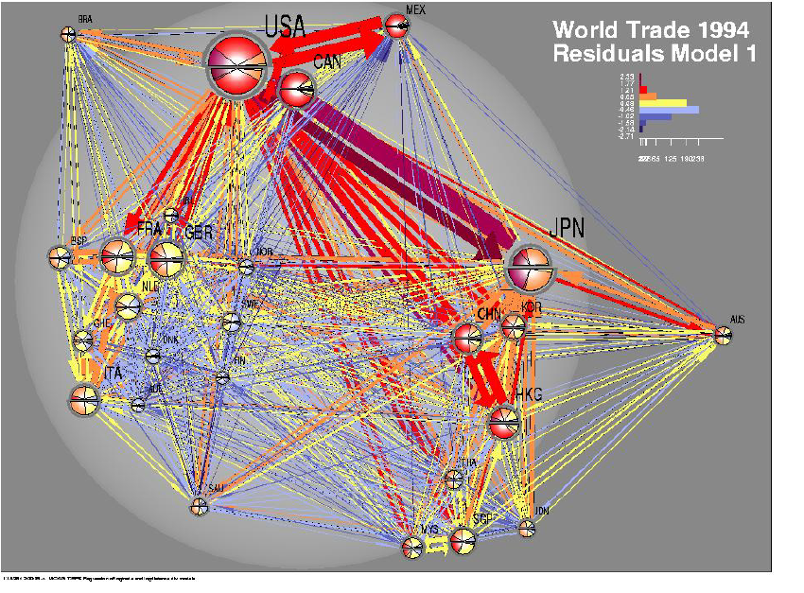
Easley and Kleinberg (2010, p.10)

Slide 11
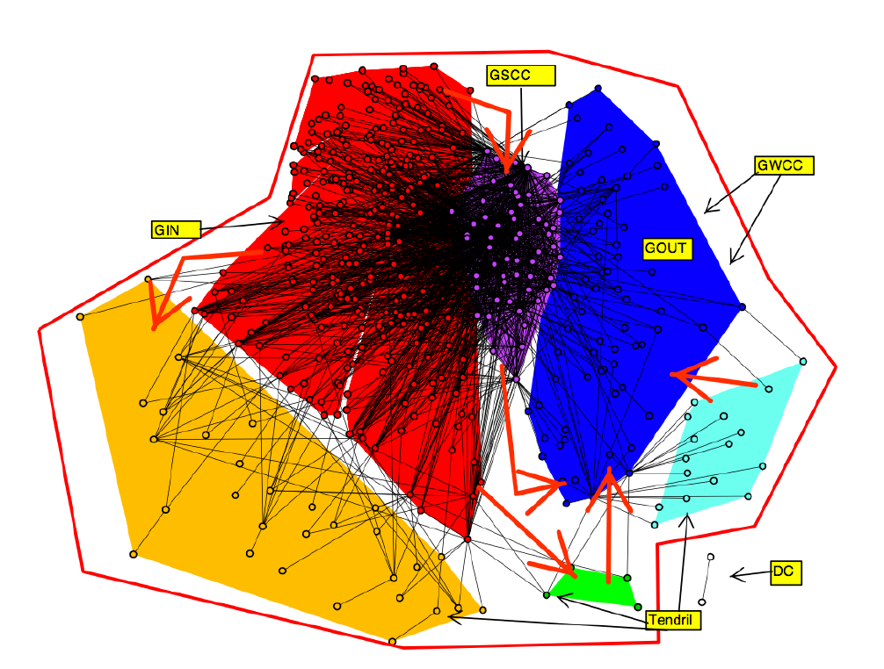
Easley and Kleinberg (2010, p.3)
Notes:
Figure 1.3. The network of loans among financial institutions can be used to analyze the roles
that different participants play in the financial system, and how the interactions among these
roles affect the health of individual participants and the system as a whole The network here
is annotated in a way that reveals its dense core, according to a scheme we will encounter in
Chapter 13. (Image from Bech and Atalay [49].)

Slide 12
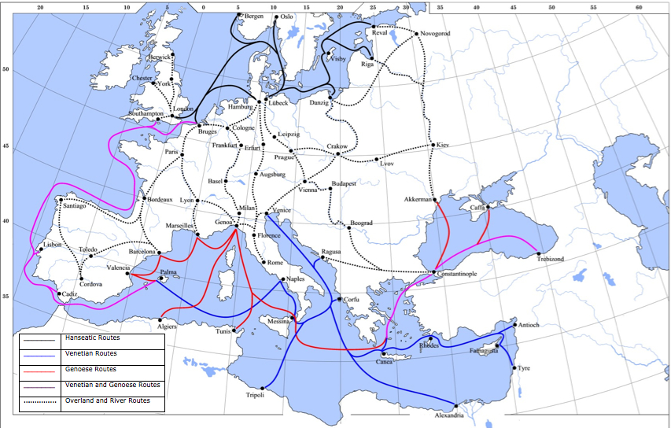
https://commons.wikimedia.org/wiki/File:Late_Medieval_Trade_Routes.jpg (accessed Jan. 7, 2016)
Easley and Kleinberg (2010, p.11)
Notes:
Figure 1.9. In some settings, such as this map of Medieval trade routes, physical networks constrain the patterns of interaction, giving certain participants an intrinsic economic advantage based on their network position. Image from https://commons.wikimedia.org/wiki/File:Late_Medieval_Trade_Routes.jp; (accessed Jan. 7, 2016)g)

Slide 13
Information networks
Online information has a fundamental network structure (e.g. political blogs)
Google’s PageRank algorithm
Prominence is based on receiving links from other prominent pages (an elegant mathematical formulation resolves the circularity of this definition: Eigenvector centrality)

Slide 14
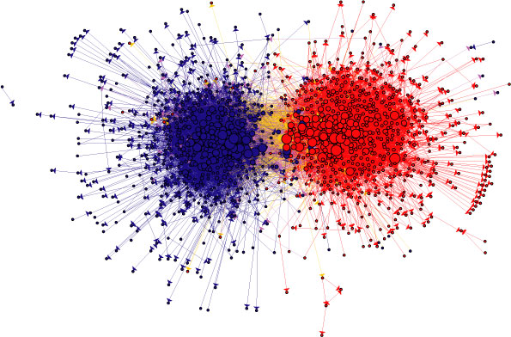

The political blogosphere and the 2004 election:
Divided they blog
Lada Adamic, HP Labs, Palo Alto, CA
joint work with Natalie Glance @ Intelliseek
http://www-personal.umich.edu/~ladamic/presentations/ (accessed Jan. 7, 2016)
Notes:
http://www-personal.umich.edu/~ladamic/presentations/ (accessed Jan. 7, 2016)
Figure 1.4. The links among Web pages can reveal densely-knit communities and prominent
sites. In this case, the network structure of political blogs prior to the 2004 U.S. Presidential
election reveals two natural and well-separated clusters [5]. (Image from http://wwwpersonal.
umich.edu/ ladamic/img/politicalblogs.jpg)

Slide 15
Network dynamics: Population effects
Network influence, and tendency to conform
What others do conveys information

Slide 16
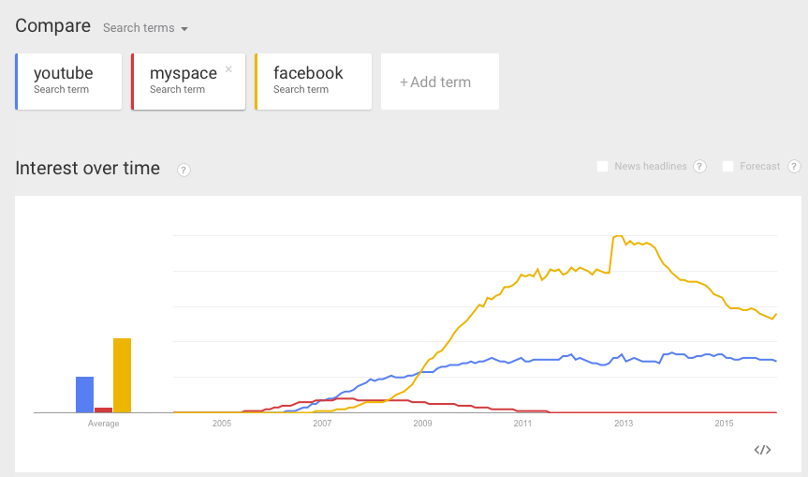
Google trends: accessed Jan. 7, 2016

Slide 17
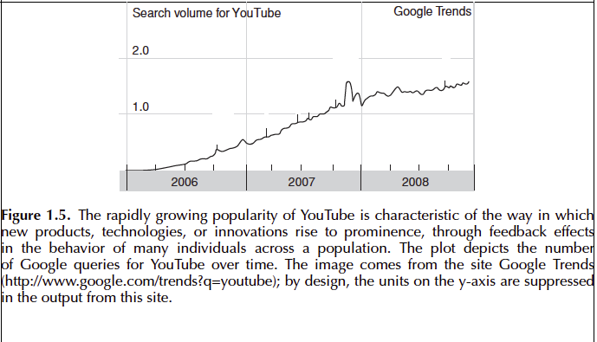
Easley and Kleinberg (2010, p.5)

Slide 18
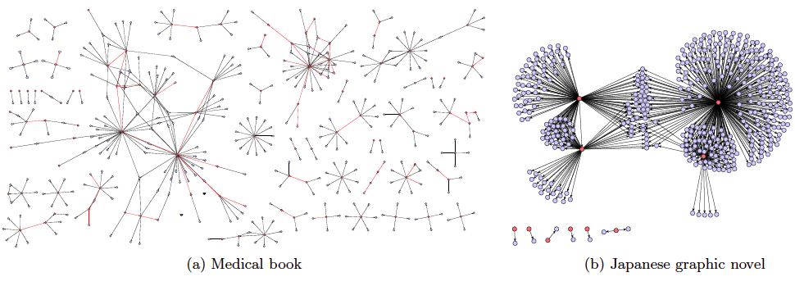
Network dynamics: Structural effects
Cascading effects, and social contagion
Figure 1.11. Adoption of a new product or innovation can cascade through the network structure. (Images from Leskovec et al. [267].) [caption from Easley and Kleinberg, p. 14]
The Dynamics of Viral Marketing, by J. Leskovec, L. Adamic, and B. Huberman (2006): https://cs.stanford.edu/people/jure/pubs/viral-ec06.pdf
(accessed Jan. 7, 2016)
Notes:
Initial adopters are the red nodes.

Slide 19
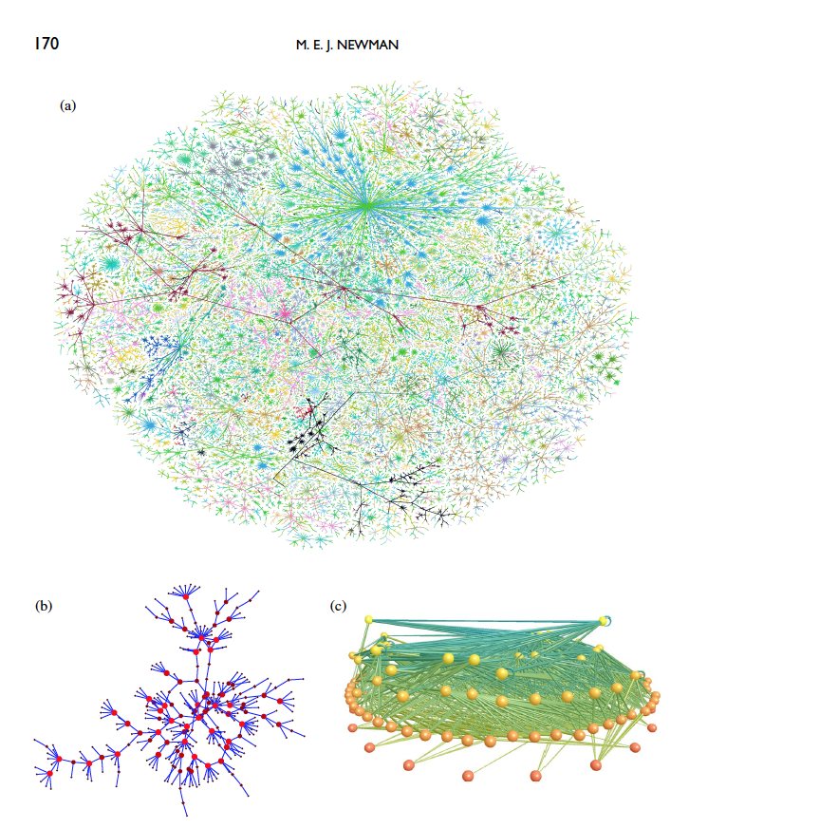
Newman (2003), “The Structure and Function of Complex Networks”, SIAM Review 45(2)
Notes:
Fig. 1.2 Three examples of the kinds of networks that are the topic of this review. (a) A visualization
of the network structure of the Internet at the level of “autonomous systems”—local groups
of computers each representing hundreds or thousands of machines. Picture by Hal Burch
and Bill Cheswick, courtesy of Lumeta Corporation. (b) A social network, in this case
of sexual contacts, redrawn from the HIV data of Potterat et al. [341]. (c) A food webof
predator-prey interactions between species in a freshwater lake [271]. Picture courtesy of
Richard Williams.

Slide 20
Networks in my ongoing research

Slide 21
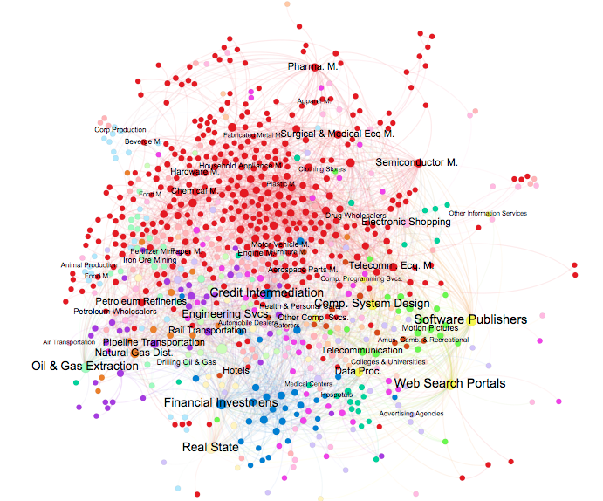
The industry space for the period from 2010 to 2014
Notes:
. In this network each node represents a six-digit level NAICS industry codes. The weights of the nodes are proportional to their degree, and the weights of the edges are set to be equal. The color of the nodes represents a higher-level grouping of the industries based on a two-digit level NAICS industry codes. This visualization of the industry space shows how industries such as telecommunication and information industries that are expected to have higher complementarities with digital (IT) industries are located in the close proximity of those industries, where industries such as oil and gas extraction or mining industries are located further away in the network. The same applies for the large cluster of manufacturing industries in which industries such as semiconductor manufacturing or telecommunication equipment manufacturing are located close to IT industries, while chemical manufacturing or beverage manufacturing industries are located at the other end of the spectrum.

Slide 22
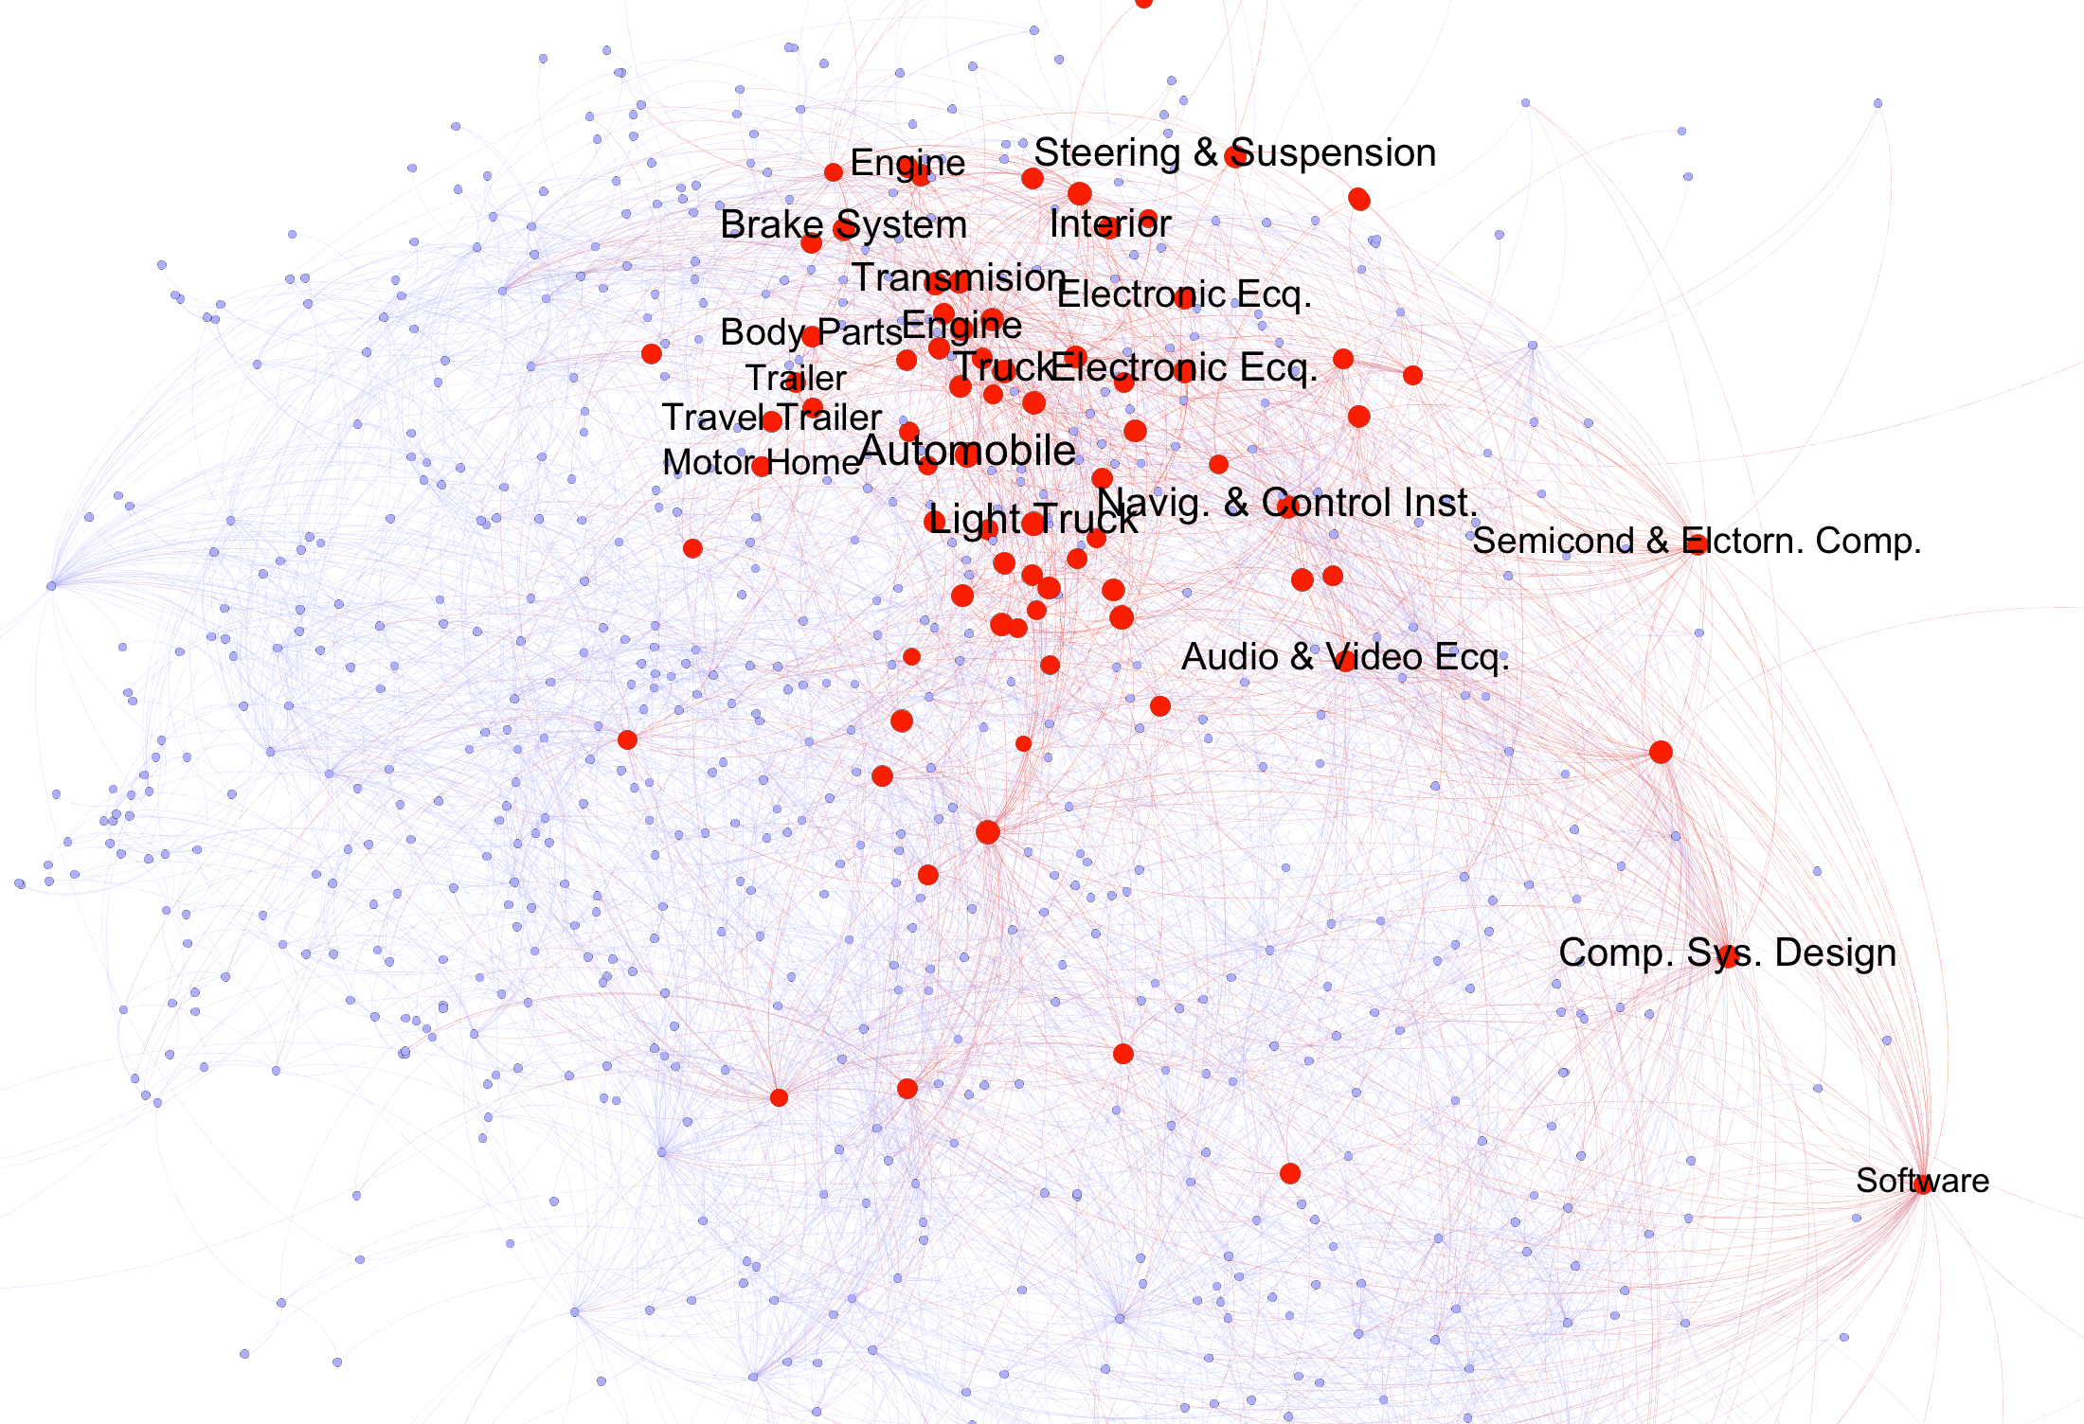
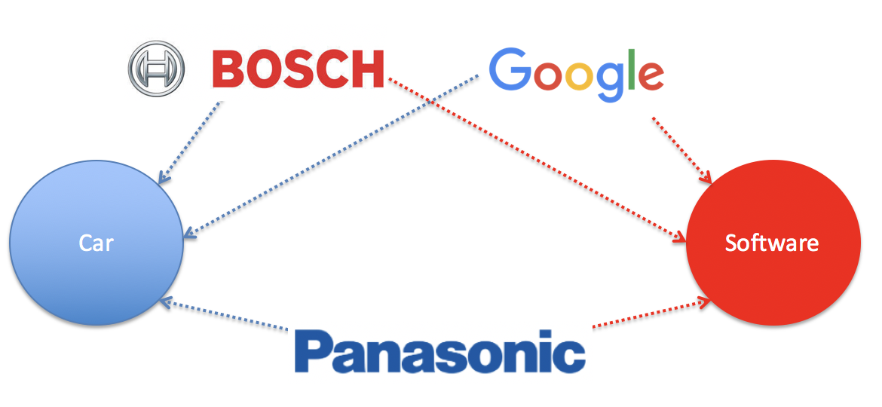
Mapping of the sales reported by all the firms in the automobile industries over the industry space network with selective labels
Notes:
The figure shows how firms in automobile industries have sales in a wide spectrum of industries from engine and brake systems to navigation and control instruments, audio and video equipment, semiconductor and electronic equipment, computer system design, and software industries. Links in the industry space are created as a result of firms’ activities in selling in more than one industry (bottom). Google is a software firm that is developing its own self-driving vehicle, Bosch is an auto part manufacturer that also sells software solutions, and Panasonic is a home appliances manufacturer that also sells both automobile parts and cloud solutions.

Slide 23
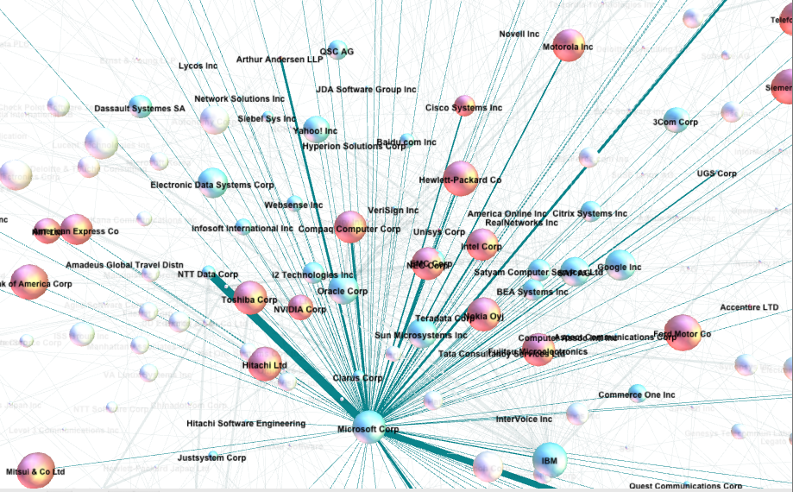
Software alliance network
Notes:
Microsoft’s alliances over a span of 15 years.

Slide 24
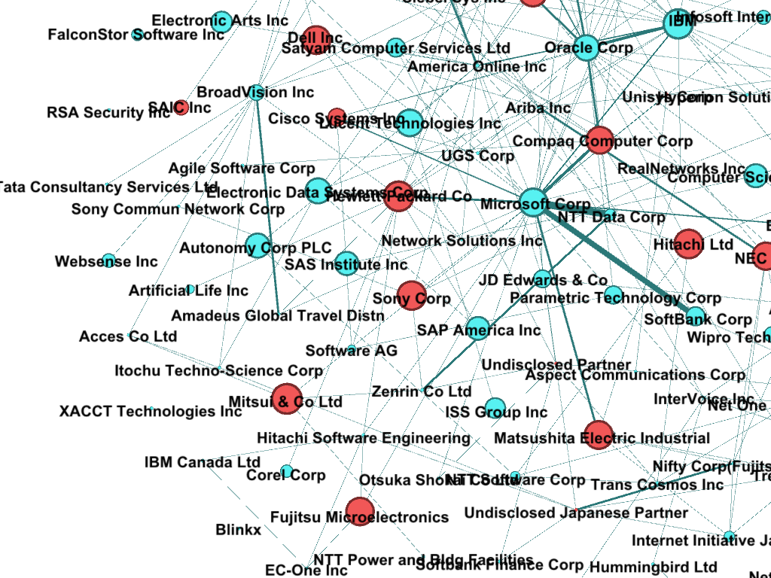
Notes:
If you look at any software we use every day, apps on the smartphone or shopping websites, or custom IT systems within our organizations; there are very few standalone products. Inevitably these are products of collaboration across many firms. These interactions also span industry boundaries. They are not just within the software industry. Products like financial software, healthcare systems, any type of service you might get over the internet, they result from recombining components of software and knowledge across many industries.

Slide 25
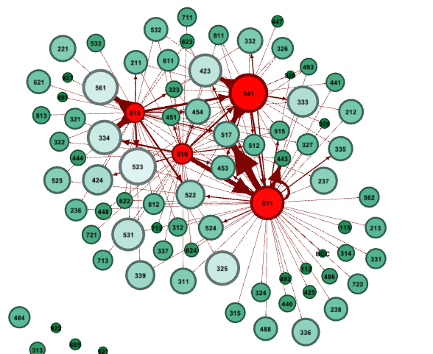
Acquisition network: software (red) and non-software (green)
511 Software Publishers:
Microsoft, Oracle, SAP, etc.
518 Internet and Data Service Providers: Xerox, Paypal, FirstData, ADP, Fiserv, etc.
519 Information Services:
Google, Yahoo, Facebook, Thomson-Reuters, Alibab, etc.
541 Systems Design:
IBM, Fujitsu, EDS, CSC, etc.

Slide 26
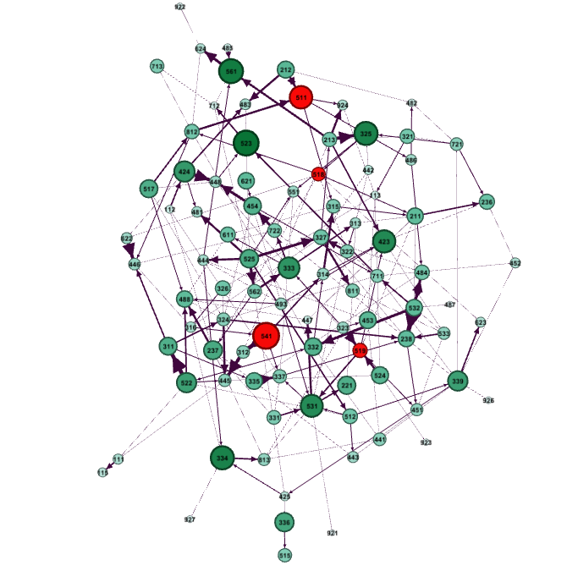
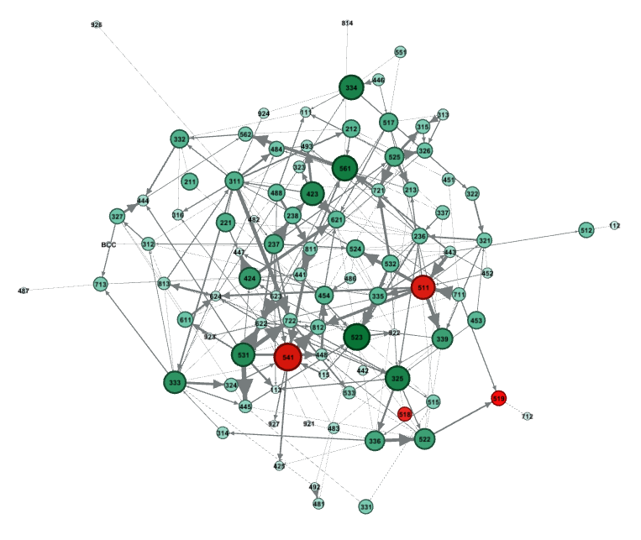
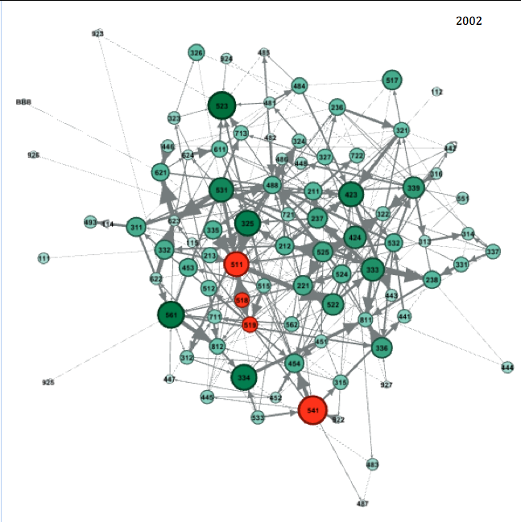
Year 2006 acquisitions
Green: Non-software industries, size and shading by ln(acquisitions)
Red: Software industries
2004
2002

Slide 27
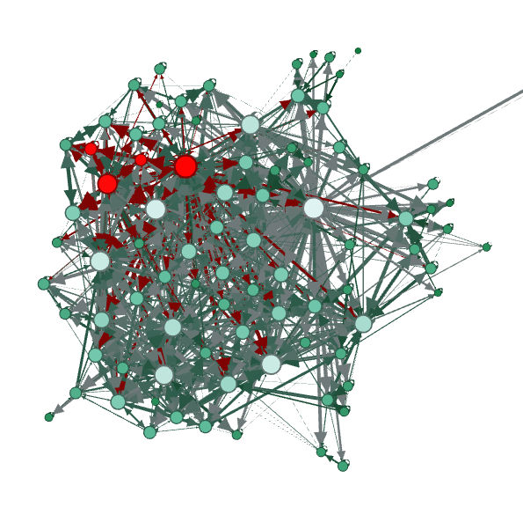
Total cumulative network 2000-2014;
log(acquisitions) are used to weight the network edges.
2006
2004
2002
Notes:
Total cumulative network 2000-2014; log(acquisitions) are used to weight the network edges. Directed edges represent an acquisition by firms in an industry (acquirers are edge sources), of firms in another industry (target firms are edge targets). Green nodes are non-software industries, while red nodes are software industries. Non-software nodes that are lighter in shade and larger in size have greater network degree. Red arrows represent acquisitions by software firms. Grey arrows represent acquisitions by non-software firms. The arrows, or directed edges, are weighted by the log of number of acquisitions. We obtained data on the acquisitions from Thomson Reuters’ SDC Platinum database. We used Gephi to generate this diagram, using the Force Atlas algorithm to arrange the nodes, where larger directed edges have an attraction force that bring nodes together.

Slide 28
Network subset
Software firm acquisitions of non-software firms, at the industry-level of aggregation.

Slide 29
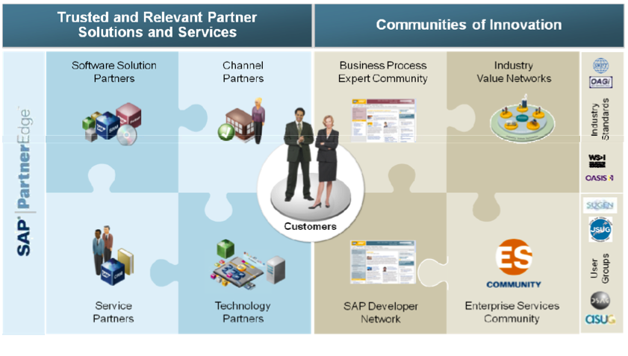
Research Context: SAP Online Community Network

Slide 30


Slide 31
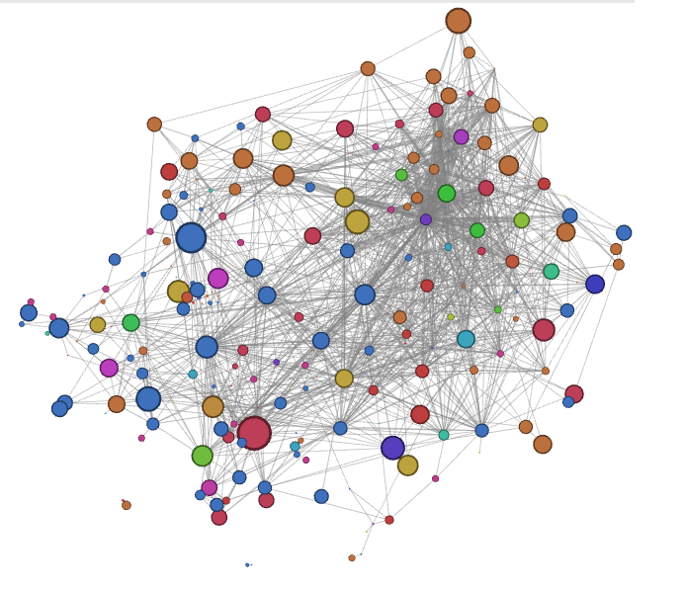
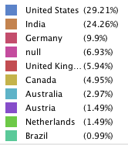
Network of Most Active Users
Size: Log(Points Earned)

Slide 32
Syllabus

Slide 33
Labs
Visualizing networks for insight
Network measures: Global and local
Fitting network models to the data
Detecting communities
Predicting new links
Modeling and predicting how information spreads on networks (e.g. epidemics and contagion)

Slide 34
Topics
Visualizing and modeling network structure
Identifying individuals with influence
Modeling and predicting how networks change over time
Modeling and predicting how information spreads on networks
Understanding strategy and games in the network context

Slide 35
Main Tools
R: Network metrics and statistical analysis
Gephi: Visualization
NetLogo: Simulation

Slide 36
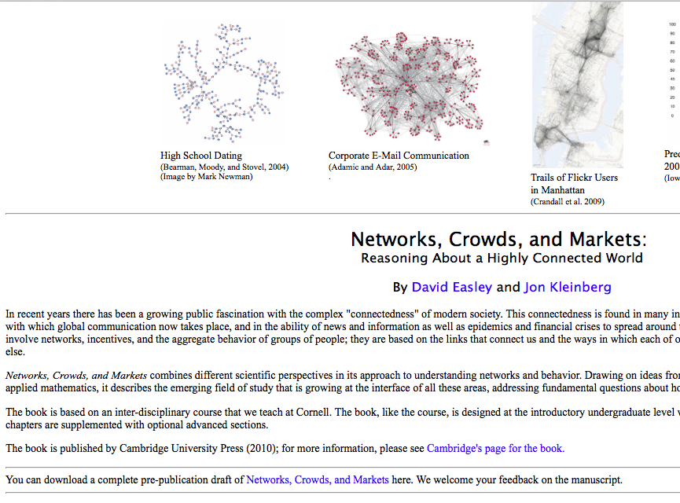
Easley and Kleinberg (2010): Basic source material, required (pre-pub draft available online, free)
https://www.cs.cornell.edu/home/kleinber/networks-book/

Slide 37

Advanced source material (optional)

Slide 38

Lab material sources (optional)

Slide 39
Gephi examples

Slide 40
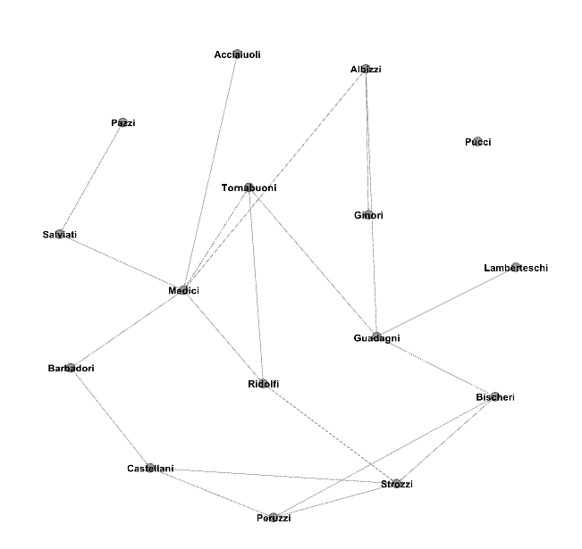
See Padgett and Ansell (1993): “Robust action and the rise of the Medici, 1400-1434,” American Journal of Sociology.

Slide 41
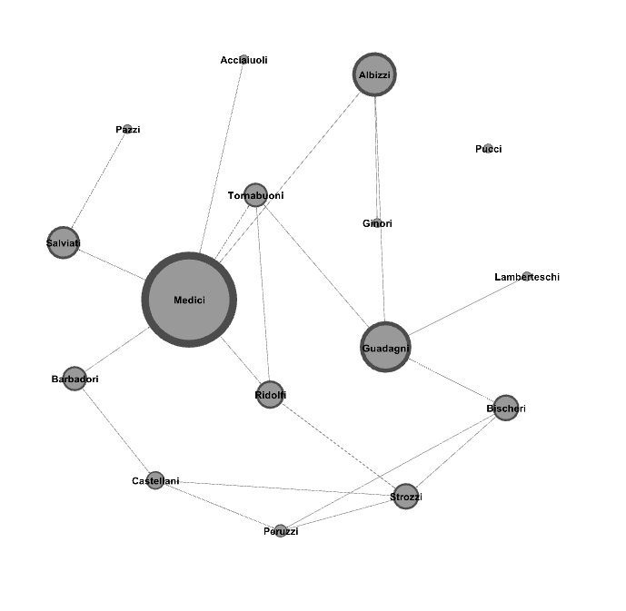
Nodes resized based on Betweeness centrality

Slide 42
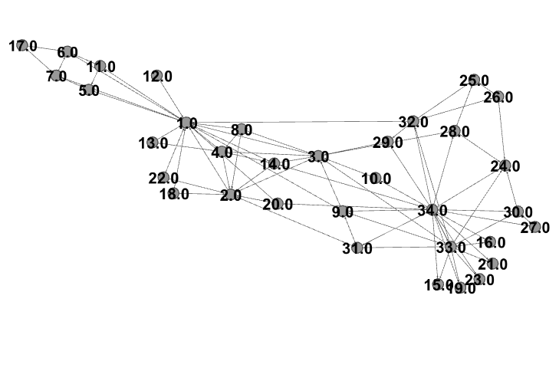
See Zachary (1977): “An Information Flow Model for Conflict and Fission in Small Groups.”

Slide 43
Homework weeks 1 &2
Download, install Gephi and do the tutorials listed in Lab 1
Lab 1/quiz 1 is due Friday January 24 (strict, no exceptions).
Consider doing Advanced Lab 1
Choose either advanced lab 1, 2 or 3 for submission on March 6
Read Easley and Kleinberg ch. 1 & 2
Optional reading: M. Jackson ch. 1 & 2
Browse & skim the optional readings in Blackboard/Resources folder

Slide 44
Prefer a book rather than Gephi website tutorials?
Obtain these very good e-books (Kindle, PDF, ePub, or read online formats…) from Packtpub:
http://www.packtpub.com/
Gephi Cookbook, by Devangana Khokhar, ed. 2015
Mastering Gephi Network Visualization, by Ken Chevron, ed. 2015

Slide 45
Project example (Spring 2018)

Slide 46
IDS 564: Spring 2018
Rashmi Mariyappa
Notes:
Rashmi Mariyappa :: IDS 564 :: Spring 2018

Slide 47



Notes:
Rashmi Mariyappa :: IDS 564 :: Spring 2018

Slide 48
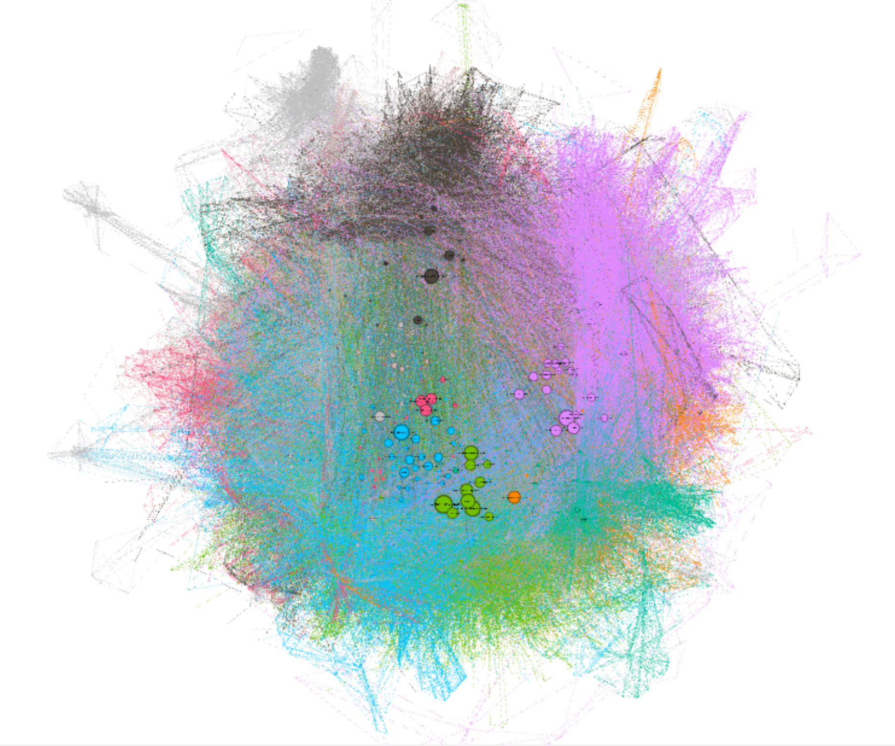
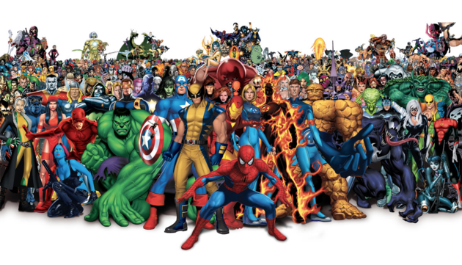
Marvel Universe Data Set
# Nodes = 6,426
# Edges = 574,467
Notes:
Rashmi Mariyappa :: IDS 564 :: Spring 2018

Slide 49
Research Problem
Marvel Universe
Notes:
Rashmi Mariyappa :: IDS 564 :: Spring 2018

Slide 50
Previous Studies
Resemblance to Real Network
General Community Detection of Teams
Local Bridges
Central Superheroes
Network Graphs
Notes:
Rashmi Mariyappa :: IDS 564 :: Spring 2018

Slide 51
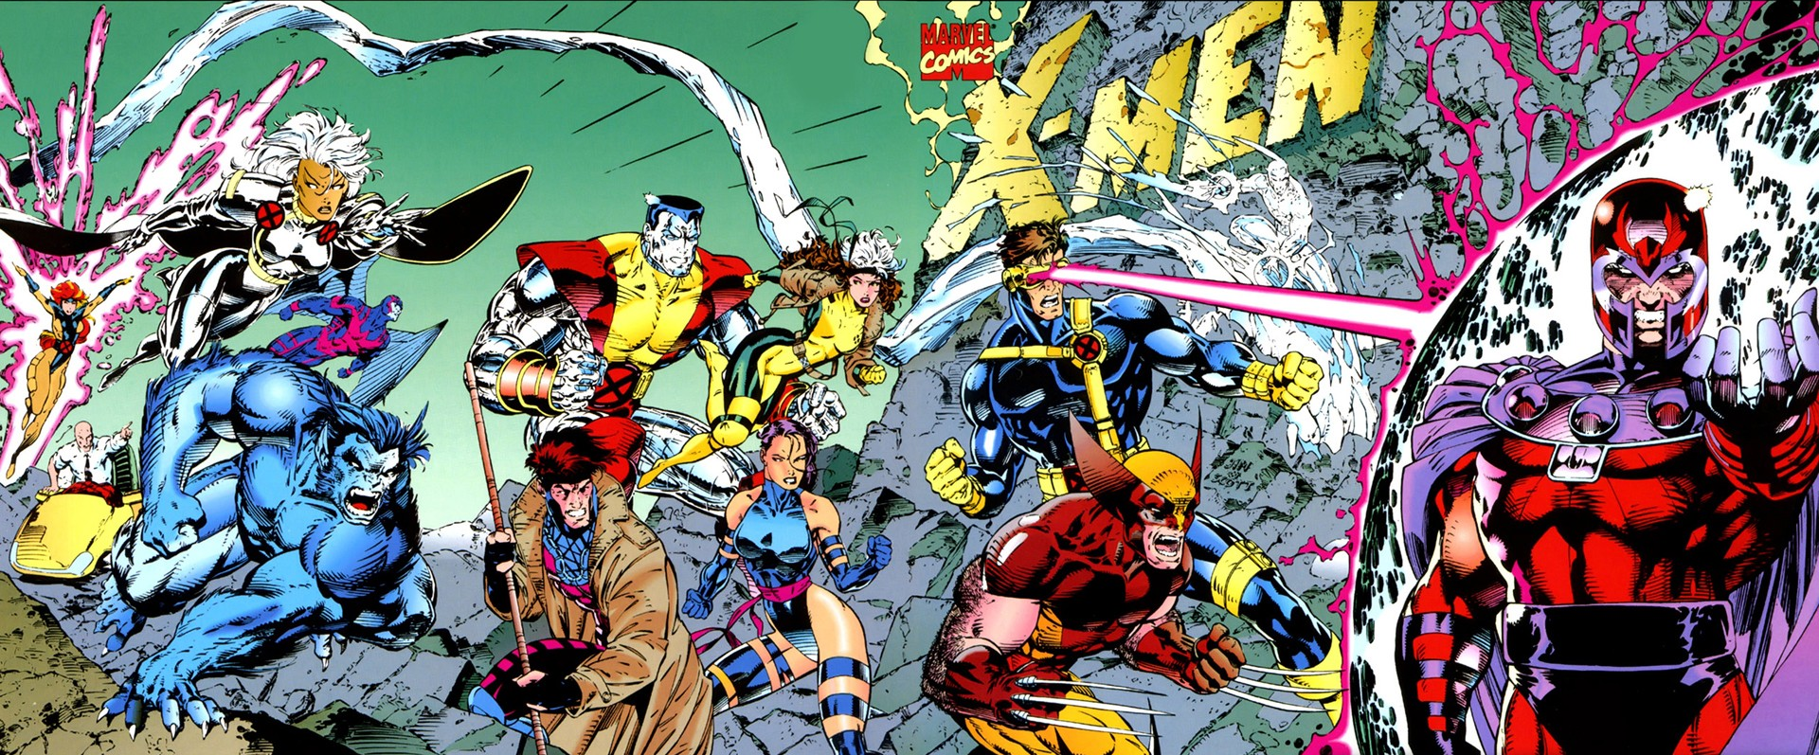
Research Topic
Who would be the leader of the X-Men if Professor X were to die?
Notes:
Rashmi Mariyappa :: IDS 564 :: Spring 2018

Slide 52
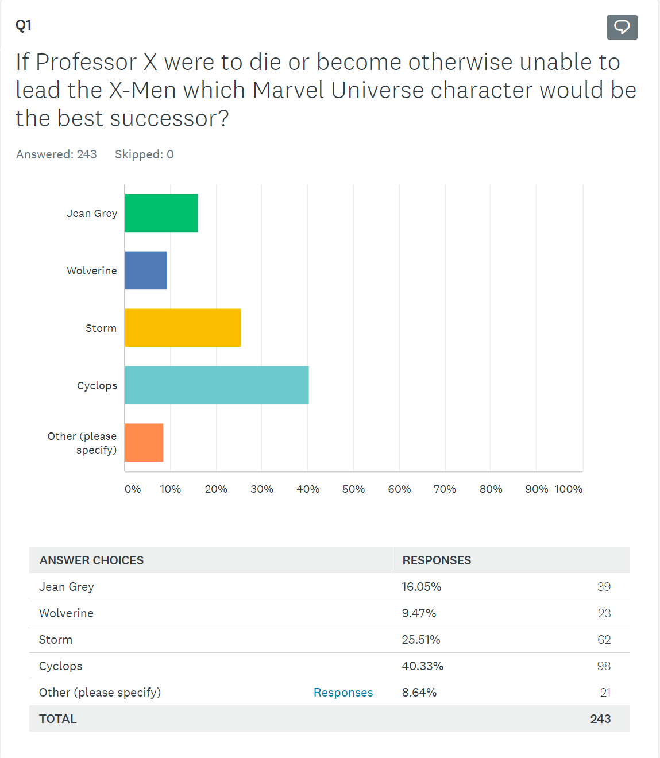
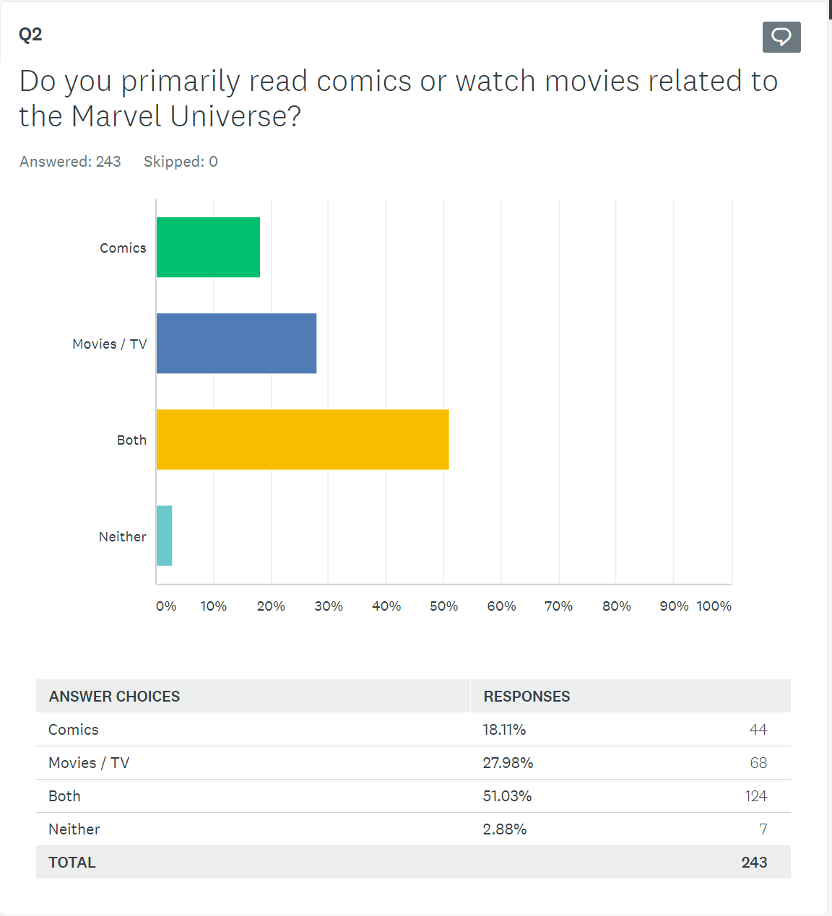
Straw Poll
Notes:
Rashmi Mariyappa :: IDS 564 :: Spring 2018

Slide 53
Network Approach
Marvel Universe
Notes:
Rashmi Mariyappa :: IDS 564 :: Spring 2018

Slide 54
Data Cleaning and Reduction
Simplify the Graph
Remove Minor Characters
Delete Edges Less than Weight 10
Delete Degree Less then 10
Community Detection to Choose the X-Men
Notes:
Rashmi Mariyappa :: IDS 564 :: Spring 2018

Slide 55
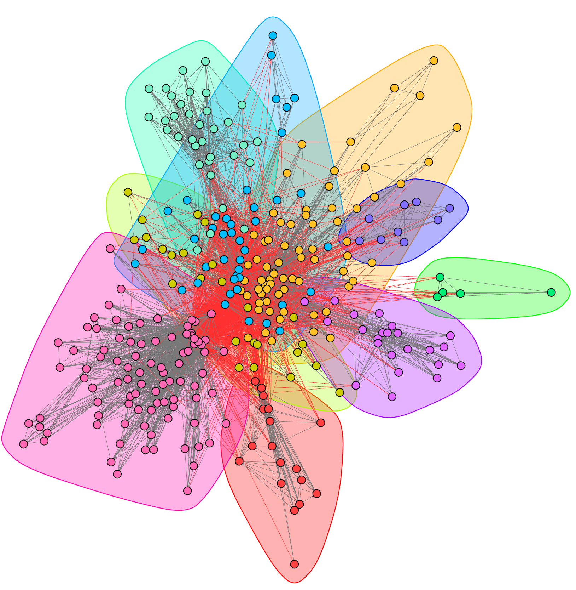
Community Detection
X-Men
Notes:
Rashmi Mariyappa :: IDS 564 :: Spring 2018

Slide 56
What Makes a Good Leader?
Being a Core Member of the Team
Being Able to Connect with Other Major Teams
Positive Relationship to the Team
Notes:
Rashmi Mariyappa :: IDS 564 :: Spring 2018

Slide 57
Network Metrics
Being a Core Member of the Team
Being Able to Connect with Other Major Teams
Positive Relationship to the Team
Eigen Centrality (X-Men Cluster)
Betweenness Centrality (Reduced Marvel Universe)
Structural Balance Analysis
Notes:
Rashmi Mariyappa :: IDS 564 :: Spring 2018

Slide 58
Eigen & BetWEENNESS CeNTRALITY
# of Degree | Rank |  | X-Man | Eigen Centrality | Betweennees Centrality
75 | 1 |  | CYCLOPS | 1.0000 | 0.3529
72 | 2 |  | STORM | 0.9448 | 0.1886
71 | 3 |  | WOLVERINE | 0.9420 | 1.0000
68 | 4 |  | COLOSSUS II | 0.8314 | 0.1498
60 | 5 |  | CANNONBALL II | 0.3715 | 0.0679
58 | 6 |  | ROGUE | 0.6161 | 0.0740
56 | 7 |  | BEAST | 0.7637 | 0.6493
56 | 8 |  | JEAN GREY | 0.7981 | 0.0140
55 | 9 |  | NIGHTCRAWLER | 0.6591 | 0.1356
54 | 10 |  | ANGEL | 0.7243 | 0.0289
Notes:
Rashmi Mariyappa :: IDS 564 :: Spring 2018

Slide 59
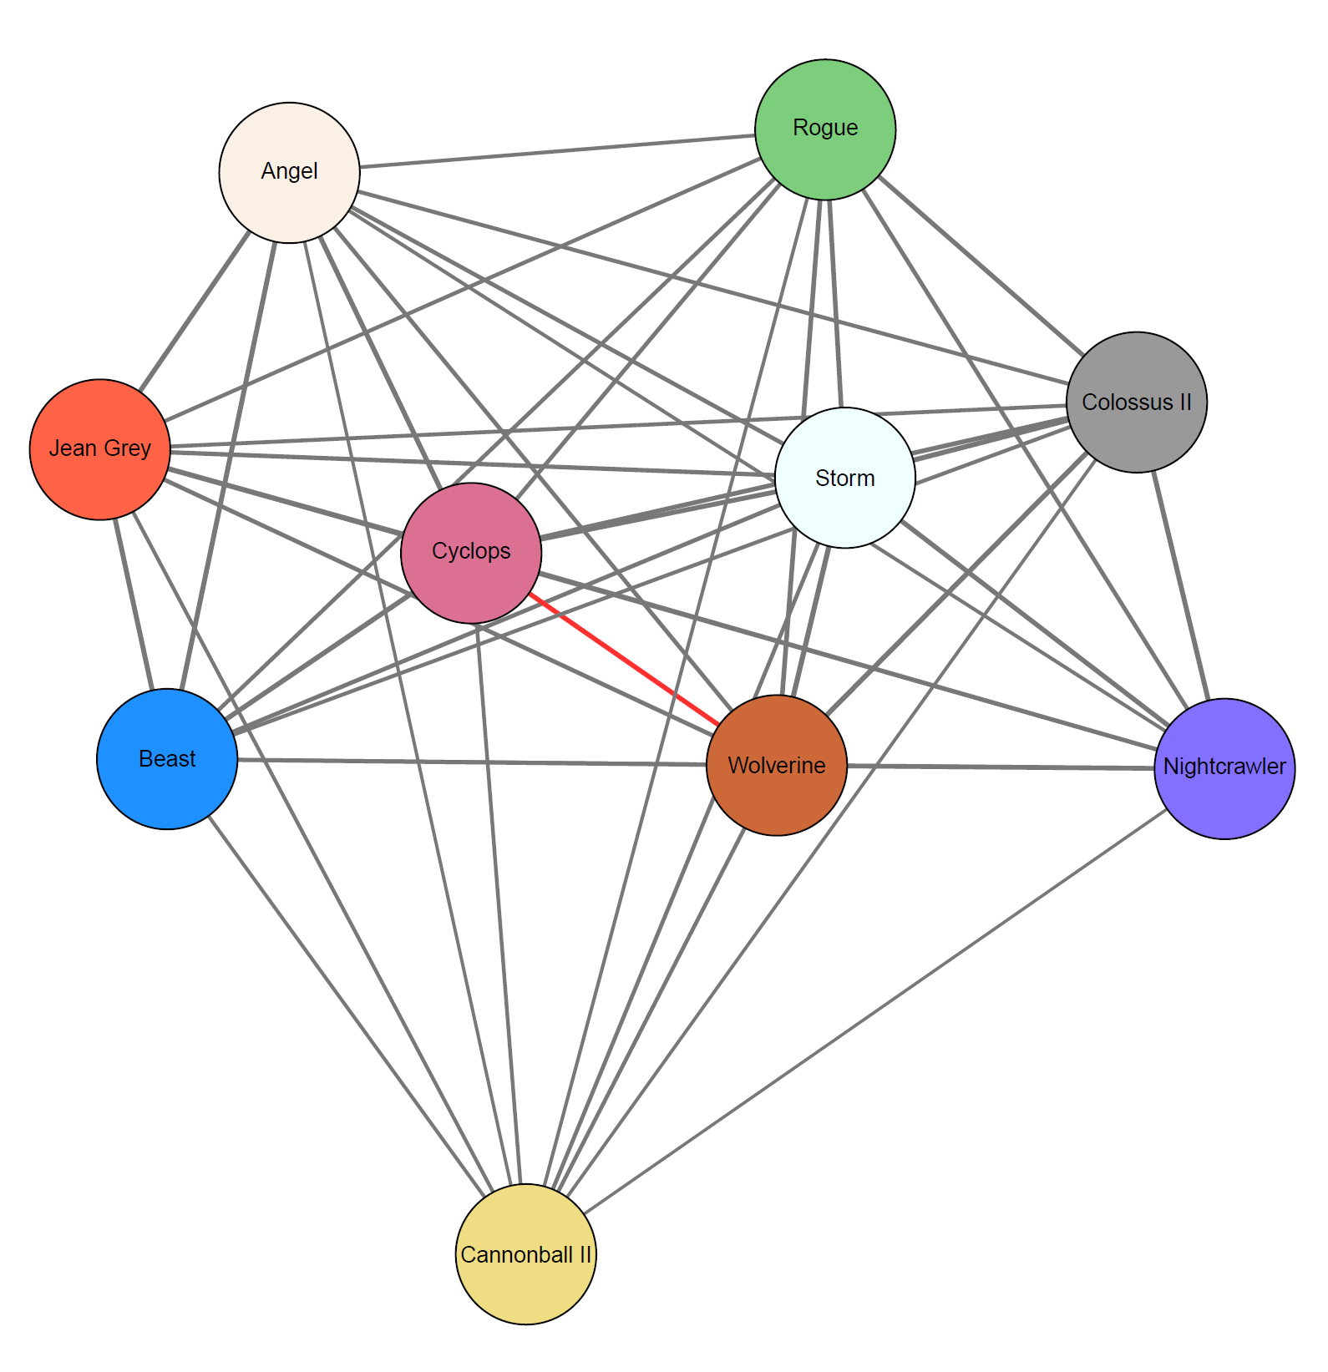
Structural Balance
Notes:
Rashmi Mariyappa :: IDS 564 :: Spring 2018

Slide 60
Final Results
Marvel Universe
Notes:
Rashmi Mariyappa :: IDS 564 :: Spring 2018

Slide 61


Winner(s)?
Who would be the leader of the X-Men if Professor X were to die?
Storm
Beast
Notes:
Rashmi Mariyappa :: IDS 564 :: Spring 2018

